Slide 1
Final Presentation: 4/28/17
This presentation has been modified from its original version in an attempt to conceal the identity of our client
John Bourassa, Yiting Chen & Juliet Zhu

Slide 2
Executive Summary
A model has been developed which can effectively predict members who will churn within the next three months. ********** can utilize this model to create automated risk scores for members, which could be used to help direct intervention strategies.

Slide 3
Timeline
11/04/16: First meeting
11/30/16: Received data
12/12/16: First progress report
02/24/17: Model prototype
04/28/17: Final presentation

Slide 4
Scope of Work
What attributes are associated with member churn?
Can member churn be predicted?
If so, can churn timing also be predicted?
Do any optimal times exist for intervention?

Slide 5
Meet Bob
22 years old
Member since June 2012
Holds two savings accounts, a checking account, and a VISA card

Slide 6

Something’s Going On; Are We Noticing?
Bob closed two of his deposit accounts this month
Bob’s point of sale usage in the past two months was a third of what it used to be
Bob stopped making deposits into his account last month

Slide 7
Bob Moves On…

Slide 8
What Could Have Been Done?
An analyst conducts a periodic risk review
She plugs Bob’s data into a predictive model

Slide 9

Alarm Bells
Bob receives three-month churn risk score of 71%
Bob is at risk!
Bob is added to the list of at-risk members

Slide 10
A Happy Ending
********** launches intervention strategy to retain Bob
Bob doesn’t cancel his membership
Bob and ********** are both better off!

Slide 11
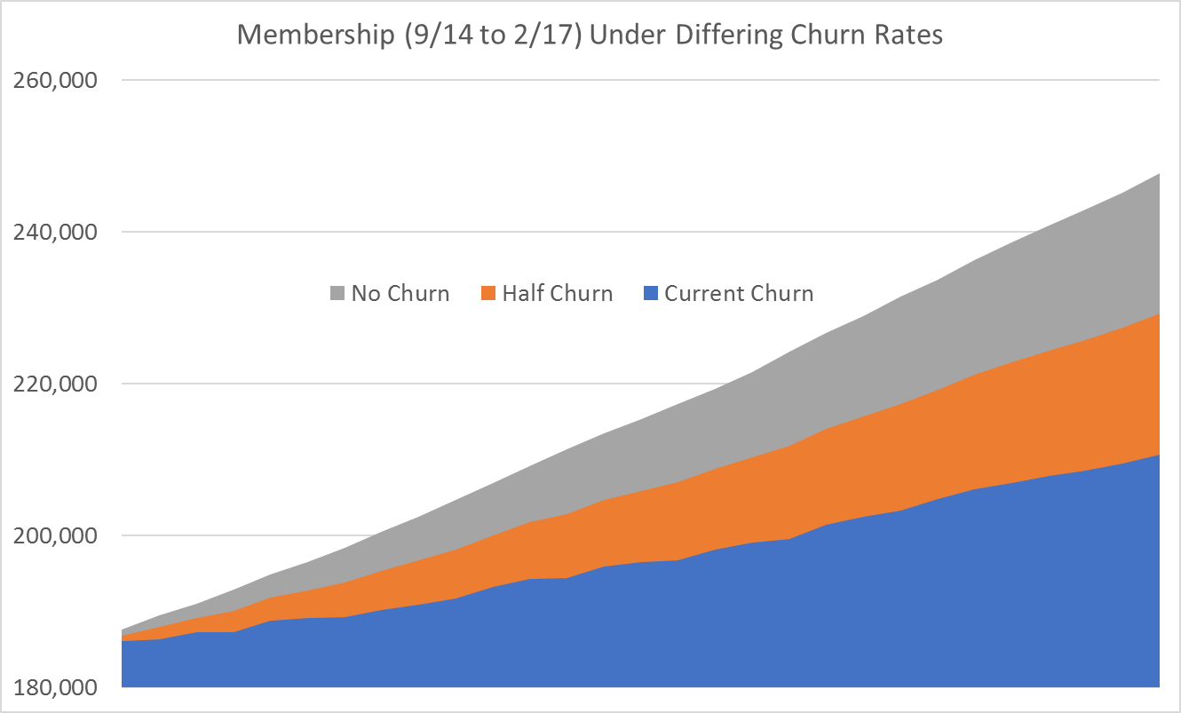
A 50% Reduction in Churn = 20,000 More Members
247,797
229,249
210,700

Slide 12
Our Model is Extremely Effective
Model built using original 25 months of data
Model tested against four additional months of unseen data
Results:
Only 5% of member population targeted, but 58% of churners are captured
Overall prediction accuracy of 96%
17% of members targeted actually churned

Slide 13
What Could Be…
Automated scoring for other dimensions
For example: Likelihood of early loan repayment
Cluster members into different risk or importance groups
Perform A/B testing to find most effective interventions

Slide 14
…With Some Hard Work
We have worked on this project for a semester and a half
Some of the extract-transform-load (ETL) code takes hours to run
This requires a broad range of skills:
Programming ability
Statistical understanding
Domain expertise

Slide 15
Questions?

Slide 16
Appendix
Model Details & Methodology

Slide 17
Methods and Tools
Data preparation
Cleaning, transforming, aggregating, and summarizing
Python’s pandas module
Churn likelihood model
Classification tree
Logistic Regression
Base R, along with R’s rpart and rpart.plot libraries
Churn timing model
Complementary log-log model
R’s survival and survminer libraries
SAS PROC LOGISTIC

Slide 18
Transformation & Feature Generation
Roll up accounts-level data to the member level
Over 100 features generated, for example:
Trends in account balances, number and type of accounts
Recent credit card activity and credit utilization
Tools used
Python
R

Slide 19
Features
Member-Level:
Age
Credit Card User
Debit Card User
Direct Deposit User
Account Charge-Off History

Slide 20
Features
Month-Level:
Total Dollar Value of All Deposit Accounts
Total Dollar Value of All Credit Accounts
Number of Deposit Accounts
Number of Credit Accounts
Number of Withdrawals Made
Number of Deposits Made
Number of Withdrawals at Non-********** Institutions
Number of Deposits at Non-********** Institutions

Slide 21
Features
Month-Level:
Number of Teller Transactions
Number of Point-of-Sale Transactions
Number of Long-Term Deposit Accounts
Number of Long-Term Credit Accounts
Percentage Utilization of Total Credit Limit
Obtained most recent as well as historical values for each month up to 6 months prior
Created trend variables (% change from previous value)
Created incremental variables (this month value – last month value)

Slide 22
Example Partition Model Performance
Identified 8,596 members as churners
6,652 of those members actually churned
Precision: 77.4%
Total member churn was 9,801
Model found 6,652 churners
Recall: 67.9%

Slide 23
YES NO
Total Value of Deposit Accounts > $5.00?
Condition in Rectangles
Length of Membership >= 1 Year?
Does Member Have Any Credit Account?
3.4%
Has Member Made a Deposit This Month?
12%
Is Member Enrolled in Direct Deposit?
16%
Does Member Owe ********** More Than $4,000?
9.1%
80%
17%
71%
Churn Probability in Ovals

Slide 24
Example Logistic Regression Performance
Precision: 74.6%
Recall: 56.9%

Slide 25
Logistic Regression Interpretation
Numbers listed are log-odds (logit) coefficients
To calculate risk score, multiply coefficient by the actual value for member (e.g. if member currently has 2 debt accounts, multiply -1.56485 by 2) for every coefficient, then sum them all
This sum is your total log-odds. Take the mathematical constant e to the power of this value (EXP function in Excel), which will give you the odds
To change from odds to probabilities, find the value of Odds / (1 + Odds)
This is the member’s churn risk score

Slide 26
Model Comparison
Logistic Regression
Classification Tree
Precision: 74.6%
Recall: 56.9%
Bear in mind that LR’s precision/recall can be easily tweaked to fit the business’ unique needs
Precision: 77.4%
Recall: 67.9%
Classification tree is not flexible: These numbers are practically set in stone

Slide 27
Churn Timing Model
Survival analysis
Originally developed for the healthcare industry
Provides insight into “time to event”
Complementary log-log model
Tools used
R – survival, survminer
SAS – PROC LOGISTIC

Slide 28
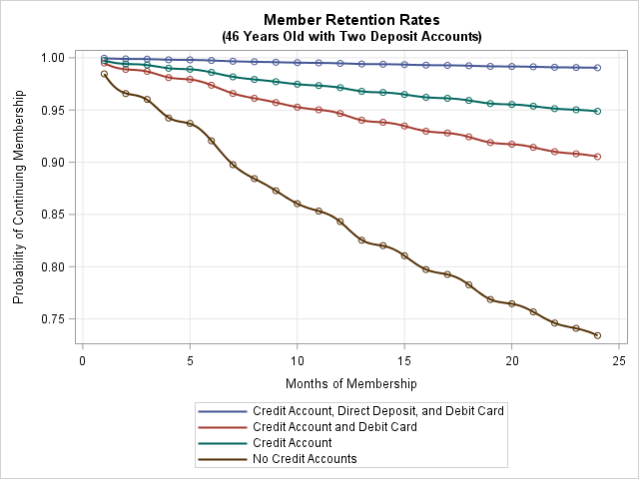

Slide 29
Final Ensemble Model
Final model generated by ensembling (combining) the predictions from both a logistic regression (LR) model and a classification tree (CT) model
Ensemble model performance trumps performance of individual models
Multiple ways to ensemble:
Add the churn risk scores together and compare to a threshold
Require both churn risk scores to be above some minimum threshold
In testing, three-month ensemble model found 58% of churners, with 17% accuracy in predictions for churn. The ensemble model targets only 5% of all ********** members, but manages to capture 58% of the churners

Slide 30
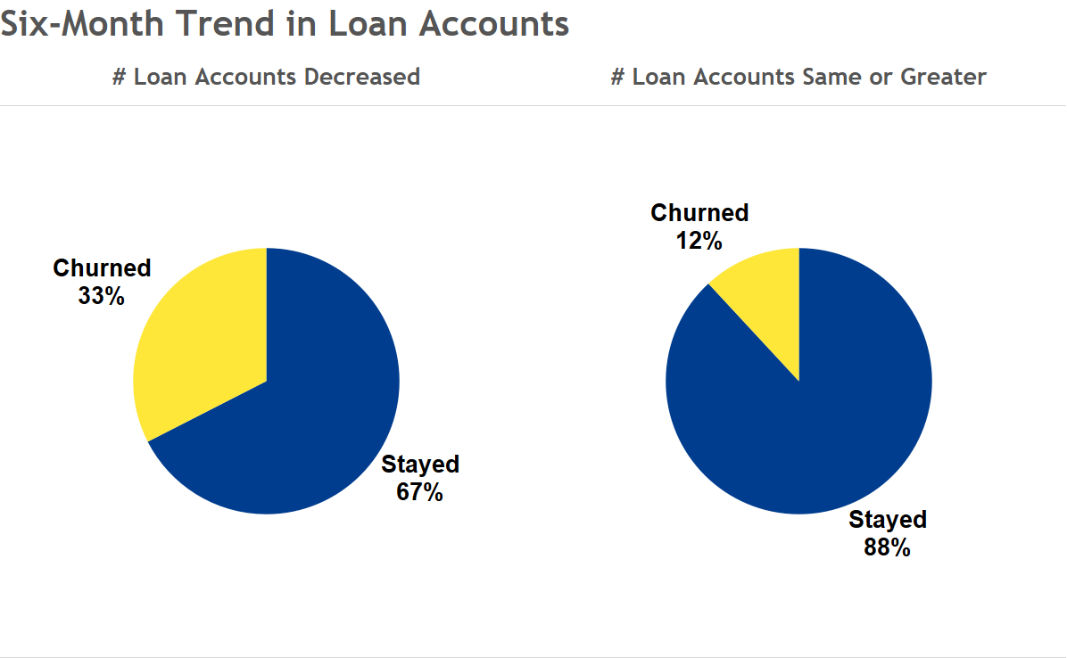
*These numbers are for two years’ worth of data. Yearly churn rates would be roughly half of what is given above

Slide 31
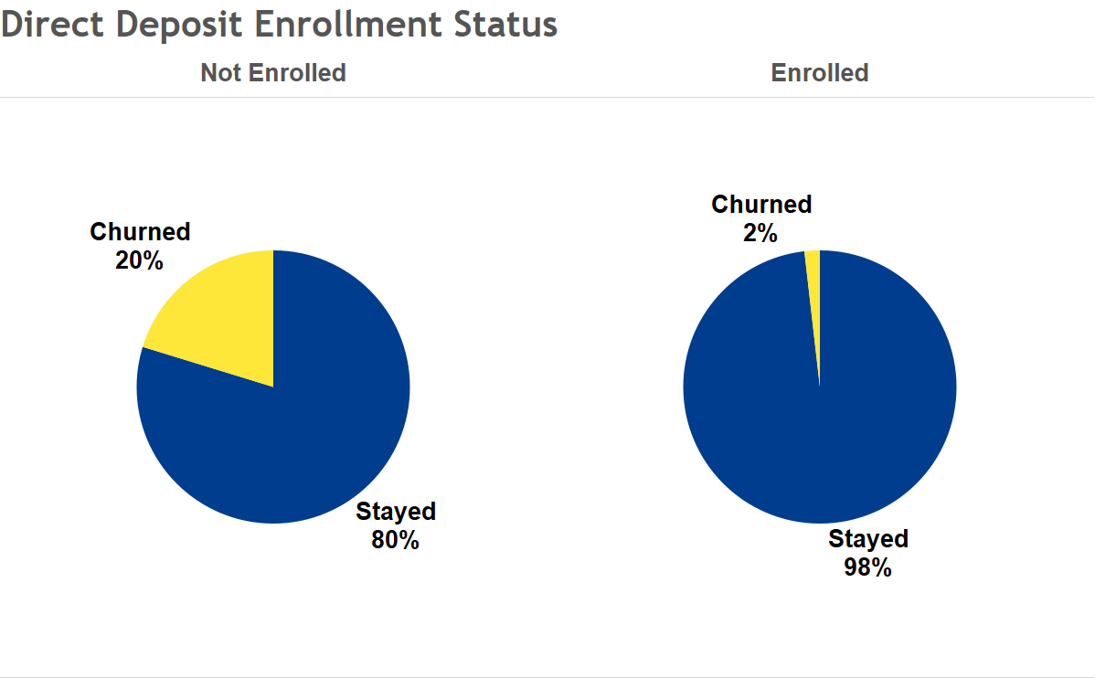
*These numbers are for two years’ worth of data. Yearly churn rates would be roughly half of what is given above

